Slide 1
COMP-4270 Operating Systems Prog2 Review
Dr. Myounggyu Won
Reference: Operating Systems Concepts – 9th Edition

Slide 2
Rationales
In many occasions in industry or academia, you may have to read and understand the code written in a language that you are not familiar with.
Although the syntax may be different, all programming languages share similar principles of programming.
Control flow (if, for, while, etc.), subroutines (e.g., functions, methods, etc.), data abstraction (e.g., class, struct, etc.), names, and types.
If you have strong background in the principles of programming (COMP4040), you should be able to read and understand a program written in a different language with some help of Googling.

Slide 3
Prog 2 is Easy and Hard
Easy because you will have to write only 10 to 20 lines of code to complete this assignment.
Hard
You have to have a good understanding of how the game simulation program (prog2.c) works in order to identify critical sections.
You have to learn how to use a synchronization tool to guard the critical sections.

Slide 4
Game Simulation
There are players of two teams.
Each player is represented as a thread.
These players (threads) run around the field randomly and try to pass and steal balls.
When the game is started, each team is given a ball – thus there are two balls.
Each player runs around the field randomly and checks if there is any adjacent player.
If he has a ball and there is an adjacent player of the same team, he will pass the ball to the adjacent player.
On the other hand, if he does not have a ball and finds an adjacent player of the opposite team having the ball, he will try to steal the ball from the adjacent player.
This pass or steal may fail randomly.

Slide 5
Data Structures

Slide 6
Data Structures (1/3)
Constant variables
/* End game after this many moves: */
#define MAX_MOVES 500000
/* Show field roughly once per epoch: */
#define MOVES_PER_EPOCH (MAX_MOVES / 10)
/* Field size: */
#define HSIZE 76
#define VSIZE 20
#define NUM_PLAYERS 4
#define NUM_BALLS 2
static const int RED_TEAM = 0;
static const int BLUE_TEAM = 1;

Slide 7
Data Structures (2/3)
Static global variables
Visible within this c file.
Shared among threads.
/* Counters: */
static int moves = 0;
static int epochs = 0;
/* Random-number state: */
static rand_state_t r;
/* Game stats (per team): */
static int passes[2] = { 0, 0 };
static int steals[2] = { 0, 0 };
RED_TEAM
BLUE_TEAM

Slide 8
Data Structures (3/3)
static struct player_t *field[VSIZE][HSIZE];
typedef struct player_t {
int rank;
int team;
int field_x, field_y;
struct ball_t *ball;
pthread_t task;
} player_t;
VSIZE
typedef struct ball_t {
int field_x, field_y;
player_t *carried_by; /* NULL => directly on field */
} ball_t;
HSIZE
static player_t red[NUM_PLAYERS];
static player_t blue[NUM_PLAYERS];
static ball_t ball[NUM_BALLS];

Slide 9
Random Number Generator

Slide 10
No need to make any change to code for the random number generator.
/**********************************************************************/
/* Random-number generator */
/* This is a stripped-down version of random.c as distributed with
FreeBSD 2.2 */
#defineDEG31
#defineSEP3
typedef struct rand_state_t {
short fpos, rpos;
int state[DEG];
} rand_state_t;
static int bsd_rand(int n, rand_state_t *r)
{
int i;
r->state[r->fpos] += r->state[r->rpos];
i = (r->state[r->fpos] >> 1) & 0x7fffffff; /* chucking least random bit */
if (++(r->fpos) >= DEG) {
r->fpos = 0;
r->rpos++;
} else if (++(r->rpos) >= DEG)
r->rpos = 0;
return i % n;
}
static void bsd_srand(int x, rand_state_t *r)
{
register int i;
r->state[0] = x & 0x7fffffff;
for (i = 1; i < DEG; i++) {
register long hi, lo, v;
v = r->state[i - 1];
hi = v / 127773;
lo = v % 127773;
v = 16807 * lo - 2836 * hi;
if (v <= 0)
v += 0x7fffffff;
r->state[i] = v;
}
r->fpos = SEP;
r->rpos = 0;
for (i = 0; i < 10 * DEG; i++) {
(void)bsd_rand(1, r);
}
}

Slide 11
Main

Slide 12
/* Give one ball to each team: */
ball[0].carried_by = &red[0];
ball[1].carried_by = &blue[0];
for (i = 0; i < NUM_BALLS; i++) {
ball[i].carried_by->ball = &ball[i];
ball[i].field_x = ball[i].carried_by->field_x;
ball[i].field_y = ball[i].carried_by->field_y;
}
int main()
{
/* Initialize and put players on the field: */
for (i = 0; i < NUM_PLAYERS; i++) {
red[i].rank = 2*i;
red[i].field_x = i;
red[i].field_y = 0;
red[i].team = RED_TEAM;
red[i].ball = NULL;
field[0][i] = &red[i];
blue[i].rank = 2*i + 1;
blue[i].field_x = i;
blue[i].field_y = VSIZE-1;
blue[i].team = BLUE_TEAM;
blue[i].ball = NULL;
field[VSIZE-1][i] = &blue[i];
}
Arrow operator (->): gets the member
from a structure pointed by a pointer.

Slide 13
/* Start the players: */
for (i = 0; i < NUM_PLAYERS; i++) {
pthread_create(&red[i].task, NULL, run_player, &red[i]);
pthread_create(&blue[i].task, NULL, run_player, &blue[i]);
}
/* Update field display occassionally: */
while (moves < MAX_MOVES) {
if (epochs > prev_shown_epochs) {
show_field();
prev_shown_epochs = epochs;
}
}
/* Game over. Wait for players to stop, then show field
one last time (just in case). */
printf("Game over\n");
for (i = 0; i < NUM_PLAYERS; i++) {
pthread_join(red[i].task, NULL);
pthread_join(blue[i].task, NULL);
}

Slide 14
Start Routine

Slide 15
void *run_player(void *_p)
{
// p: this player, p2: other player in the vicinity
player_t *p = (player_t *)_p, *p2;
while (1) {
// move this player
// code omitted …
if ((x >= 0) && (x < HSIZE)
&& (y >= 0) && (y < VSIZE)) {
p2 = field[y][x]; // find p2 at location (y,x).
if (!p2) { // p2 = null -> no player around at (y,x).
/* move */
} else {
if (p->ball && (p->team == p2->team) && !p2->ball) {
/* try to pass */
} else if (!p->ball && (p->team != p2->team) && p2->ball) {
/* try to steal... */
} else {
/* do nothing */
}
}
}
}
}

Slide 16
/* try to pass */
if (contest(p, p2)) {
/* a pass */
p2->ball = p->ball;
p->ball->field_x = x;
p->ball->field_y = y;
p->ball->carried_by = p2;
p->ball = NULL;
passes[p->team]++;
}
/* try to steal... */
if (contest(p, p2)) {
/* a steal */
p->ball = p2->ball;
p2->ball = NULL;
p->ball->field_x = p->field_x;
p->ball->field_y = p->field_y;
p->ball->carried_by = p;
steals[p->team]++;

Slide 17
Mutex Lock

Slide 18
Mutex Lock
pthread_mutex_t lock;
Random Generator()
Run_player()
{
…
pthread_mutex_lock(&lock);
critical section
pthread_mutex_unlock(&lock);
…
}
…
Show_field() { … }
Contest() { … }
Main()
{
if (pthread_mutex_init(&lock, NULL) != 0)
{
printf("\n mutex init failed\n");
return 1;
}
…
…
pthread_mutex_lock(&lock);
critical section
pthread_mutex_unlock(&lock);
…
…
pthread_mutex_destroy(&lock);
}

Slide 19
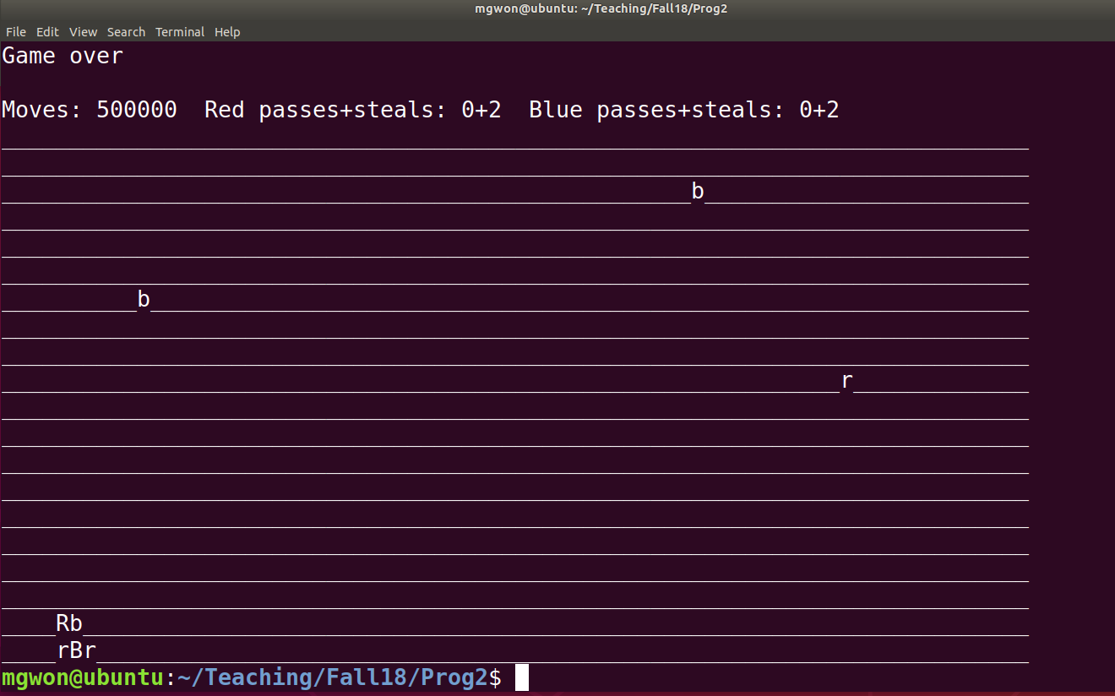
Correct Output
If everything is good, your program should output with “game over” and Moves of 500000.

